Slide 1
Fourier Transforms
Fourier Transform
Inverse Fourier Transform
Fourier Sine Transform
Fourier Cosine Transform

Slide 2
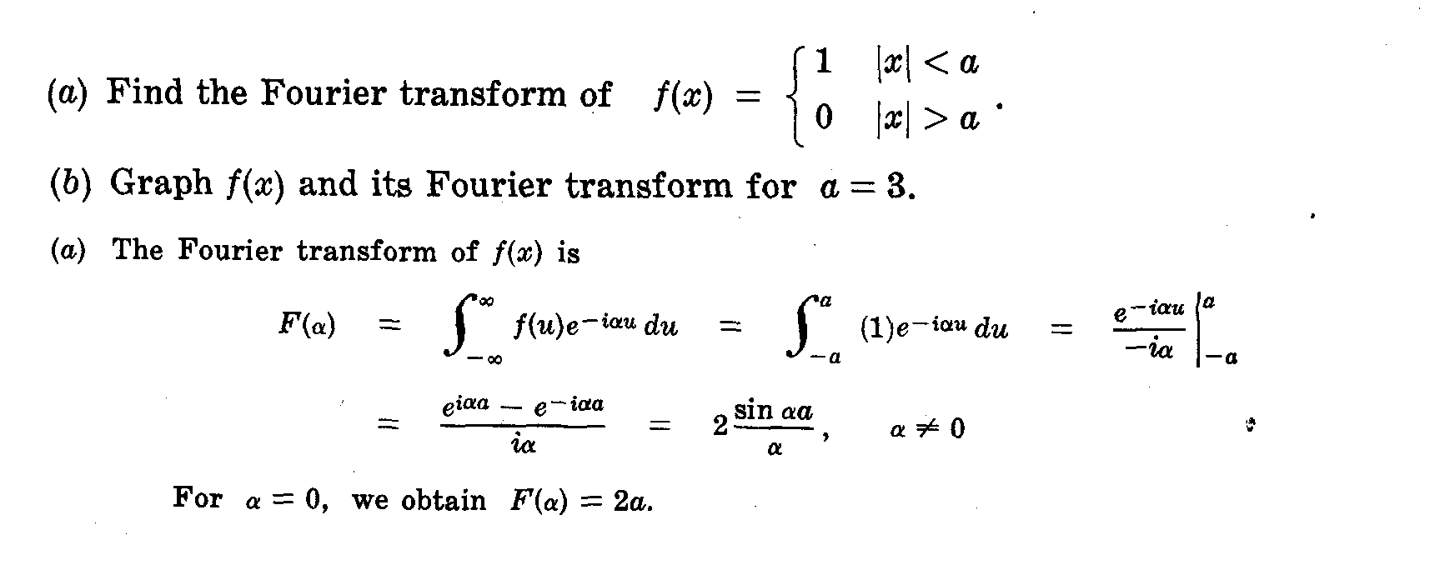

Slide 3
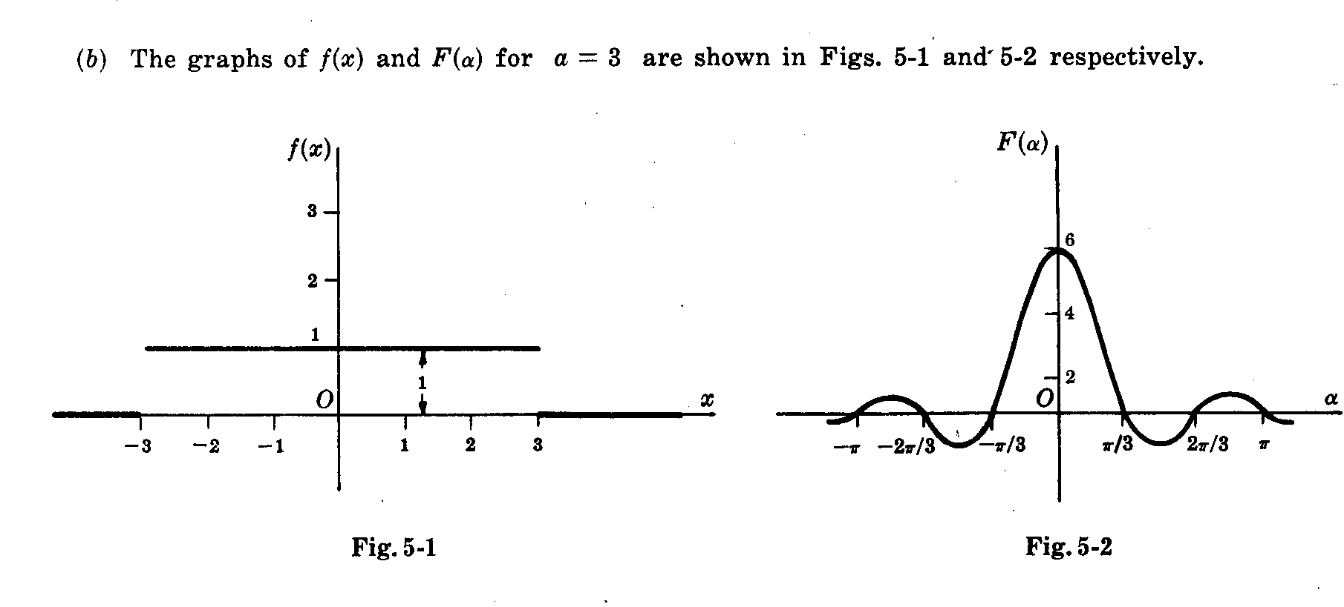

Slide 4
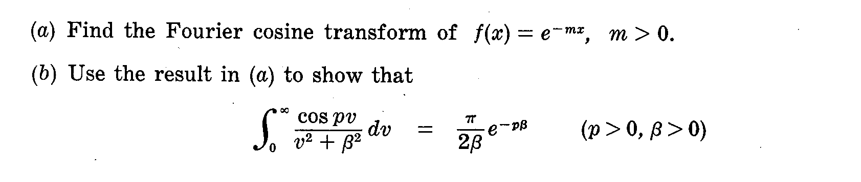
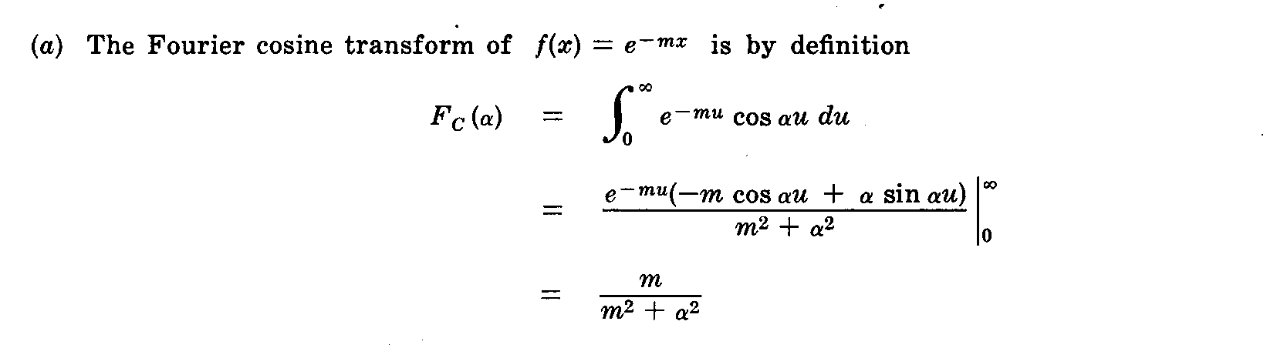

Slide 5
